Slide 1

FrodoKEM

Slide 2


Introduction
Key encapsulation
Post quantum families
Sub- family
FrodoKEM’s algorithm
Attacks
Advantages and Disadvantages
Demo

Slide 3




Symmetric encryption
Technique where the same key is used for both encrypting and decrypting the data.
BOB
EVE
Alice
Hi
ij
ij
Hi
ij
ij
Hi

Slide 4
Asymmetric encryption
Technique where a pair of keys: public and private, is used to encrypt and decrypt messages.
Bob’s Private
Alice’s Private
Alice’s Public
Alice’s Public
BOB
Alice
Hi
Alice’s Public
ij
Alice’s Private
ij
Hi

Slide 5


Key-encapsulation
FrodoKEM is a Key-encapsulation mechanism.
encryption technique designed to secure symmetric cryptographic key using asymmetric algorithms.
In asymmetric communication it takes a lot of time to convey relatively long messages.
But, asymmetric communication is more secure.

Slide 6
Key-encapsulation
Thus, there is a combination between the two:
Alice is Generating
Secret key
Public key and sends it to Bob.
Bob is encrypting and sending his public key using Alice’s public key.
Alice decrypts Bob’s message using her private key.
Now them both have the same public key!
The rest of the communication is done by symmetric algorithm.

Slide 7
Post quantum families
There are 6 families of encryption that are considered resistance to quantum computers:
Lattice- based
Code-based
Hash-based
Non-commutative
Multivariate
Isogeny-based

Slide 8



lattice-based
Private key: good base.
Public key: bad base.
What is a base?
Good
Bad
A vector that you can
Go to any lattice with
It.

Slide 9
lattice-based
Good base: short and almost orthogonal.
Allows to efficiently solve the closest vector problem.
Bad base: the opposite.

Slide 10
lattice-based
The problem: the snail is
Hungry, which lettuce is
The closest?
Easy if we are in 2D!
What about in 250D?

Slide 11
lattice-based
This problem is called: shortest vector problem (SVP).
If we have a good base it’s relatively easy to find the closest lattice (polynomial time).
If we have a bas base it’s relatively hard (exponential time)

Slide 12
Learning with errors
A sub-family of lattice.
Based on The problem: Given an equation system,
We add little mistakes in some of the aquations.
Find the mistakes without knowing the variables values.

Slide 13
Learning with errors
Adding small errors
294x + 629y + 321z = 38 (mod 797)
701x + 29y + 91z = 462 (mod 797)
613x + 339y + 201z = 636 (mod 797)
256x + 94y + 115z = 522 (mod 797)
704x + 629y + 322z = 477 (mod 797)
391x + 23y + 743z = 213 (mod 797)
290x + 620y + 201z = 40 (mod 797)
211x + 339y + 381z = 510 (mod 797)
+1
-2
+1
-1
+2
+1

Slide 14
Learning with errors
294x + 629y + 321z = 39 (mod 797)
701x + 29y + 91z = 460 (mod 797)
613x + 339y + 201z = 636 (mod 797)
256x + 94y + 115z = 523 (mod 797)
704x + 629y + 322z = 477 (mod 797)
391x + 23y + 743z = 212 (mod 797)
290x + 620y + 201z = 42 (mod 797)
211x + 339y + 381z = 511 (mod 797)

Slide 15
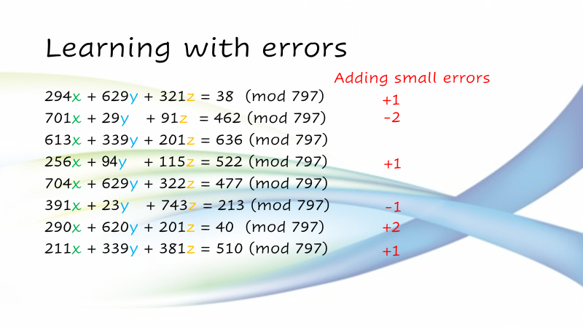
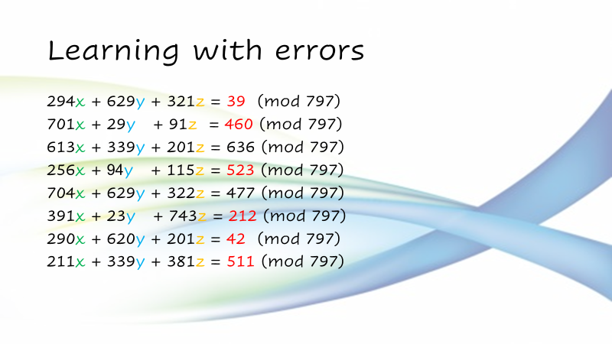
Learning with errors
This is a one-way function:
Adding errors is easy! Finding them is difficult!

Slide 16
LWE - Generating the public key
A is a vector of n random numbers modulo q (prime).
( n = 20, q = 97, s = 5)
A = [80, 86, 19, 62, 2, 83, 25, 47, 20, 58, 45, 15, 30, 68, 4, 13, 8, 6, 42, 92]
E is a vector of n little errors.
E = [3, 3, 4, 1, 3, 3, 4, 4, 1, 4, 3, 3, 2, 2, 3, 2, 4, 4, 1, 3]
Bi = Ai * s + Ei (mod q)
B = [15, 45, 2, 20, 13, 30, 32, 45, 4, 3, 34, 78, 55, 51, 23, 67, 44, 34, 17, 15]

Slide 17
LWE - Keys
Public key: (A, B)
A = [80, 86, 19, 62, 2, 83, 25, 47, 20, 58, 45, 15, 30, 68, 4, 13, 8, 6, 42, 92]
B = [15, 45, 2, 20, 13, 30, 32, 45, 4, 3, 34, 78, 55, 51, 23, 67, 44, 34, 17, 15]
Private key: s
S = 5

Slide 18
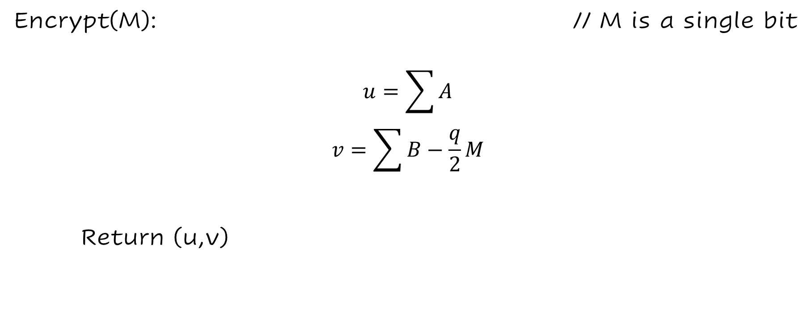
LWE - Encryption
Encrypt(M): // M is a single bit
$$u=\sum{A}$$
$$v=\sum{B}−\frac{q}{2}M$$
Return (u,v)

Slide 19
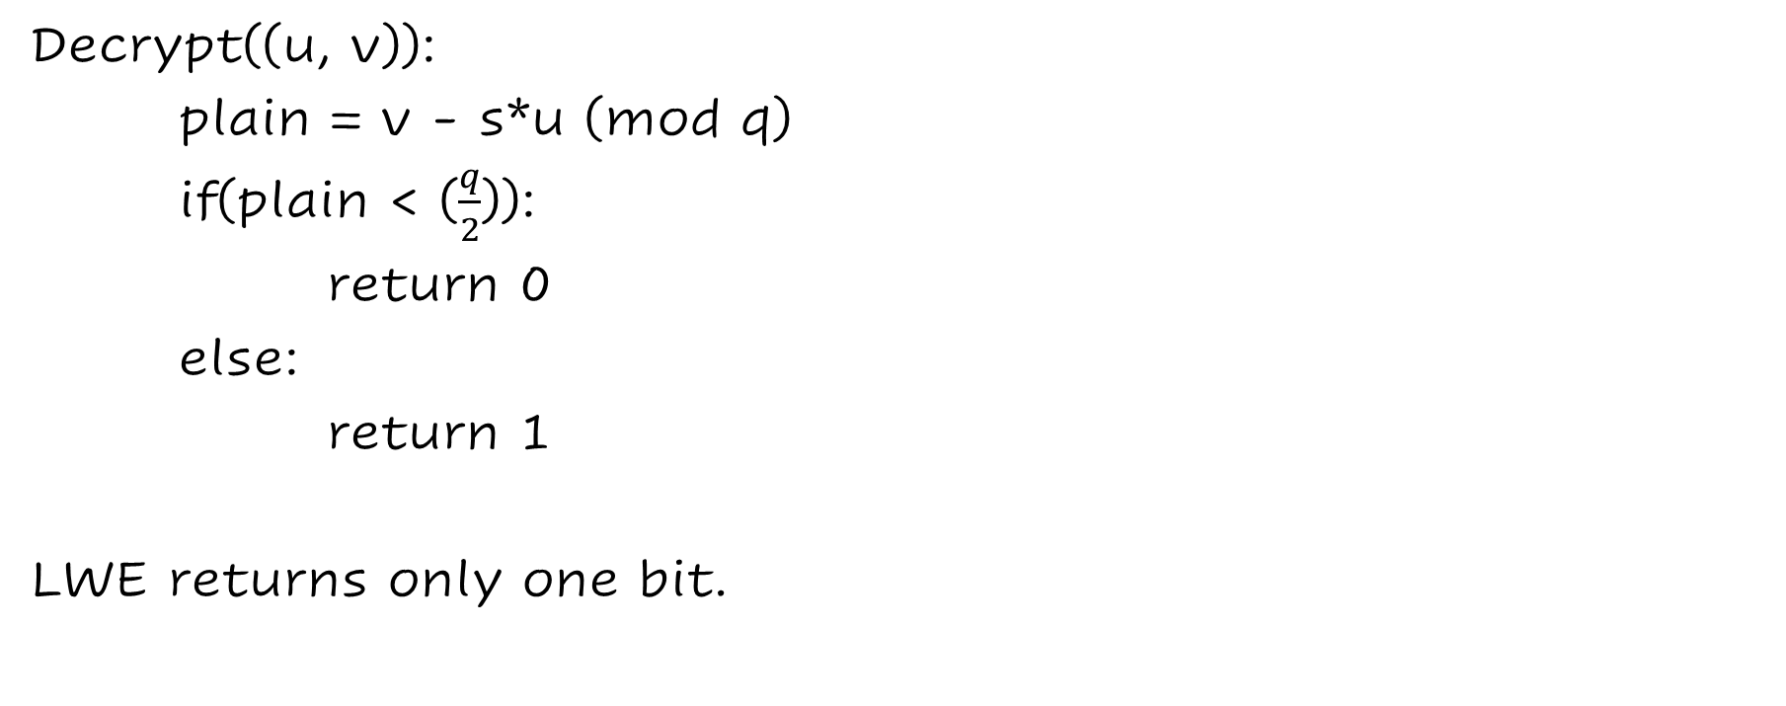
LWE - Decryption
Decrypt((u, v)):
plain = v - s*u (mod q)
if(plain < ($\frac{q}{2}$)):
return 0
else:
return 1
LWE returns only one bit.

Slide 20
Key generation
Alice generates a matrix A with a random seedA.
Alice generates another seedE.
Alice generates matrixes E, S with seedE.
Alice computes: B = As + E
Alice sends pk=(seedA, B) to Bob.

Slide 21
Encapsulation
Bob generates a matrix A with seedA.
Bob generates a seed: seedE.
Bob generates matrixes E’, S’, E’’ with seedE.
Bob computes: B’ = As’ + E’, V=s’B-E’’
Bob sends the encrypted message: (c1, c2)=(B’, V + msg) to Alice.

Slide 22
Decapsulation
Alice computes M = c2-c1*s .
(s is her secret key)
(c1, c2) = (B’, V + msg)

Slide 23


Attacks
Side-channel attack:
extracting secrets through measurement and analysis of physical parameters. For instance:
keyboard's click-clacking can reveal a user's password through sound alone.

Slide 24
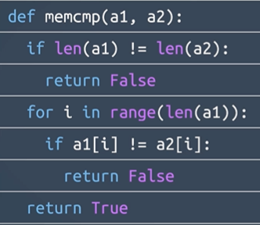
Side-channel attack
We all know c’s function memcmp.
Here is a python implementation.
What is the problem here?
IF we know the time it takes to check 1
character, we can guess a password much
More easily.

Slide 25
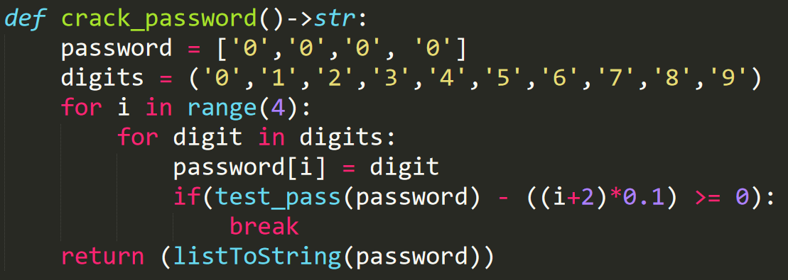
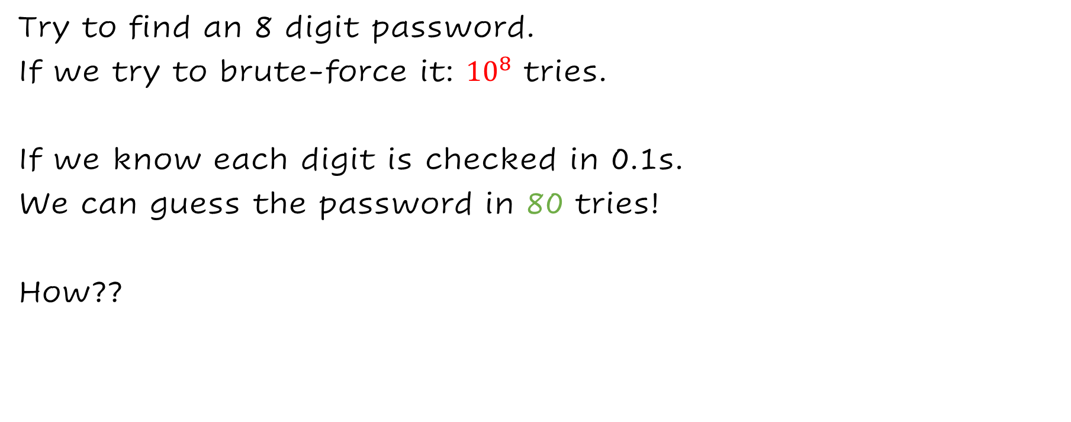
Simple Side-channel attack
Try to find an 8 digit password.
If we try to brute-force it: ${10}^{8}$ tries.
If we know each digit is checked in 0.1s.
We can guess the password in 80 tries!
How??

Slide 26
Simple Side-channel attack
0 0 0 0 0 0 0 0 0.1s : wrong 1st digit.
1 0 0 0 0 0 0 0 0.2s : wright 1st digit.
1 1 0 0 0 0 0 0 0.2s : wrong 2st digit.
1 2 0 0 0 0 0 0 0.3s : wright 2st digit.
And so on..

Slide 27
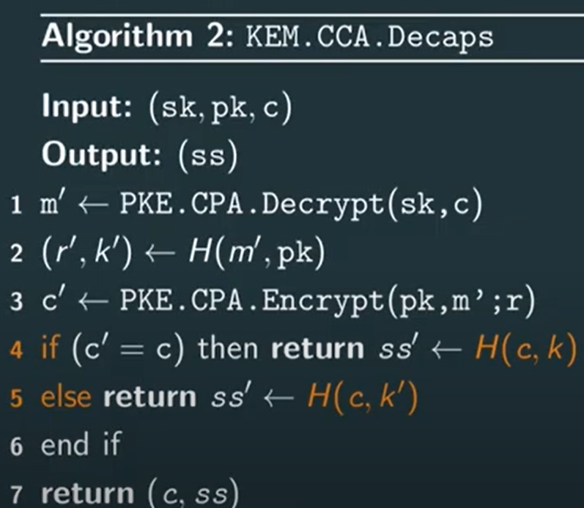
Weak point

Slide 28
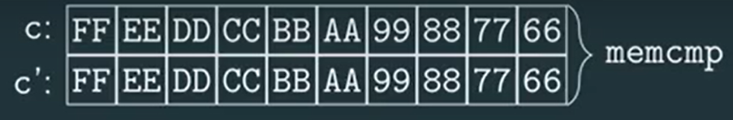
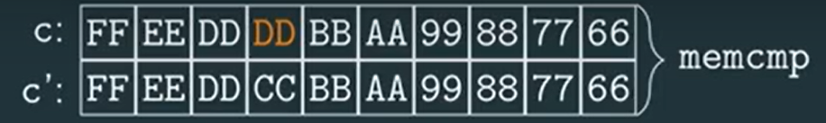
Weak point

Slide 29
So how would you fix the function?

Slide 30
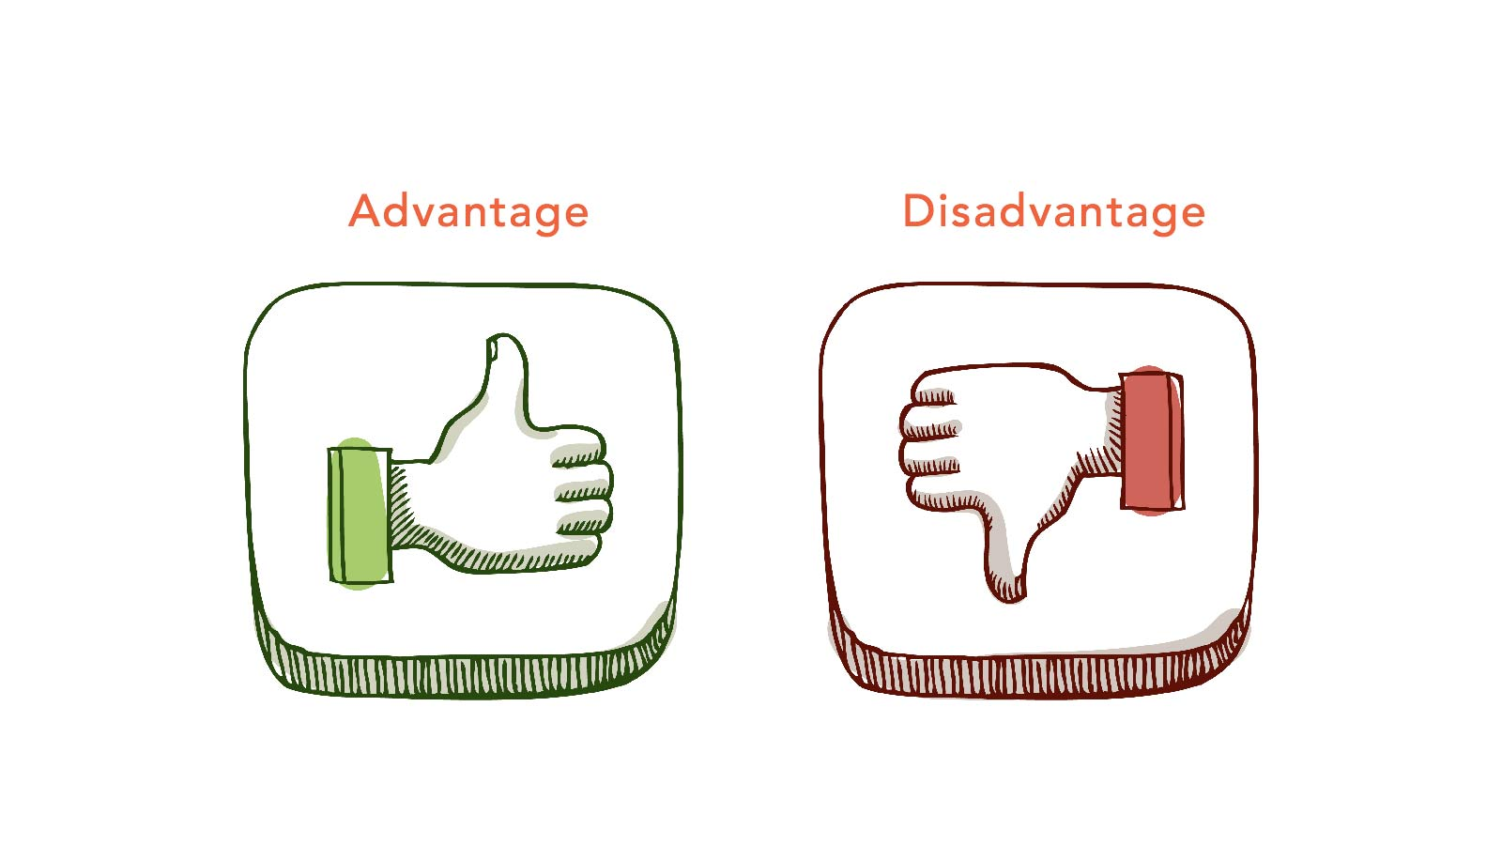

Slide 31
Advantages
Ease of implementation.
There is only one known attack against FrodoKEM.
Easy to encapsulate most of the computations required involves very simple and parallelizable operations.

Slide 32
Disadvantages
FrodoKEM has very large keys:
LWE encryption just requires vector-matrix multiplication, while FrodoKEM requires matrix-matrix multiplication.

Slide 33
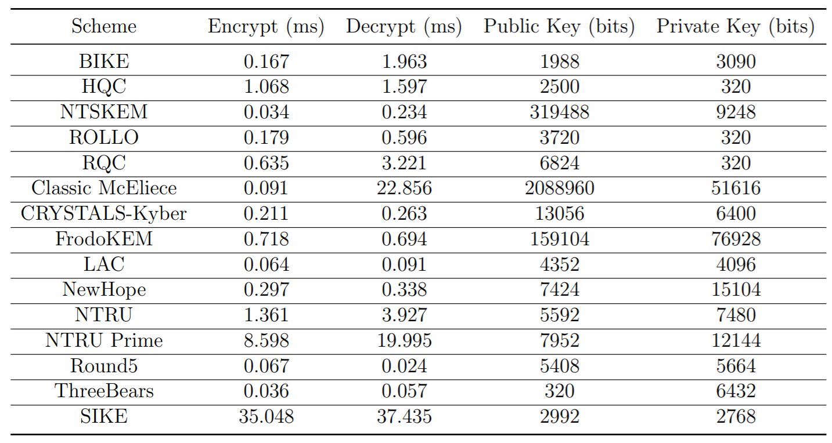
Compare to other NIST

Slide 34
DEMO

